Slide 1
Key “Players” In Psychology
AP Psych Review

Slide 2
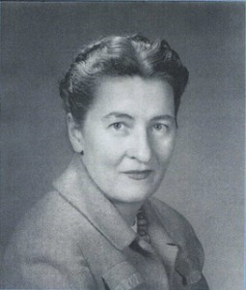
Mary Ainsworth
Emotional attachment
Her “strange situation” room that infants are placed in during attachment testing is a standard procedure
The strange situation and patterns of attachment
  Secure
  Anxious-ambivalent
  Avoidant/Insecure

Slide 3
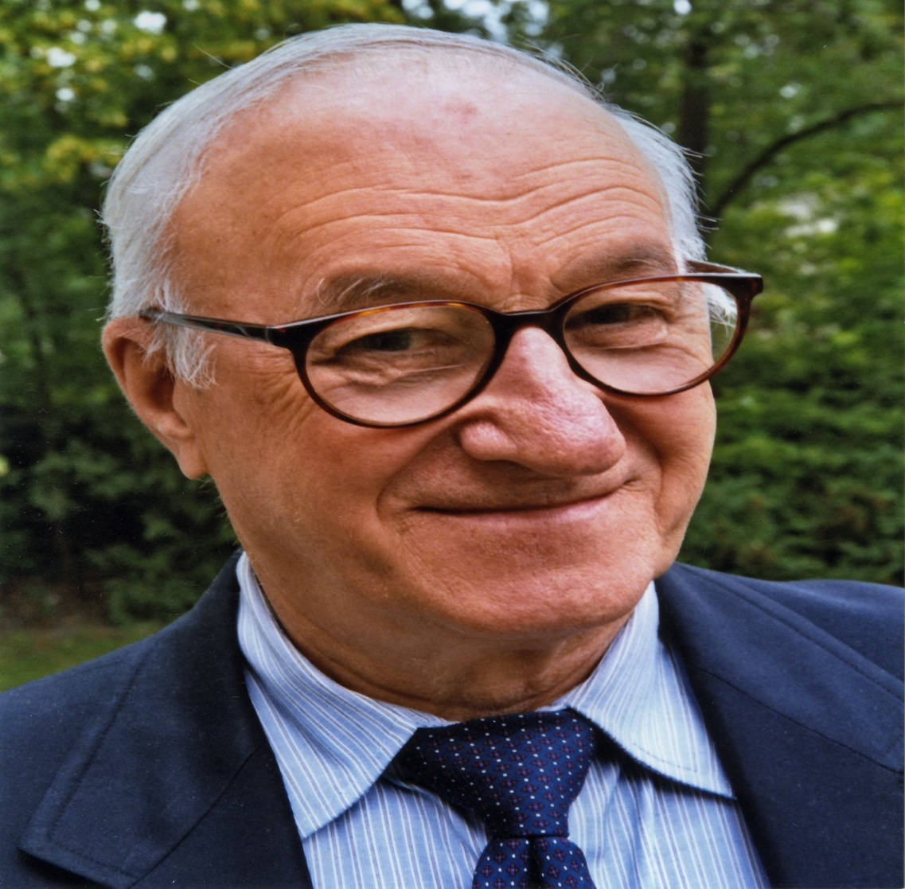
Albert Bandura
A researcher who focused on observational learning, or modeling
Bandura showed that children learn behavior by watching others. He did a famous study involving “Bobo” dolls that demonstrated children don’t need punishment or reward to learn

Slide 4
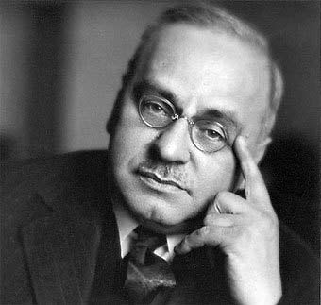
Alfred Adler
Studied under Freud
Adler broke away from Freud
He believed that social motives, rather than sexual drives, motivated people the most
In Adler’s view, strivings for superiority drive people’s behavior
He thought mental disorders were characterized by extreme feelings of inferiority and a desire for superiority over others

Slide 5
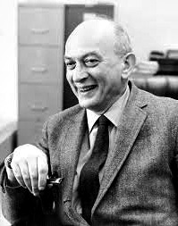
Solomon Asch
Social conformity
Studied how people reacted when their perceptions of events were challenged by others.
Asch found that most individuals changed their own opinions in order to agree with the group, even when the majority was clearly wrong

Slide 6
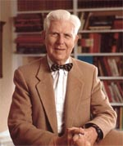
Aaron Beck
A developer of cognitive therapy
His cognitive approach to therapy emphasizes using rational thoughts to overcome fears rather than trying to uncover the unconscious meaning of those fears

Slide 7
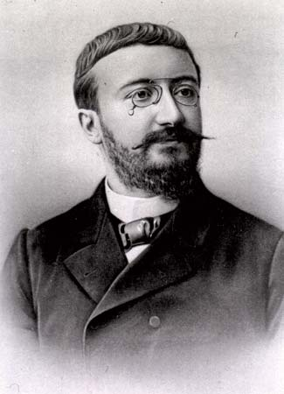
Alfred Binet
A developer of the Binet-Simon scale
Binet intended the test to predict school performance

Slide 8
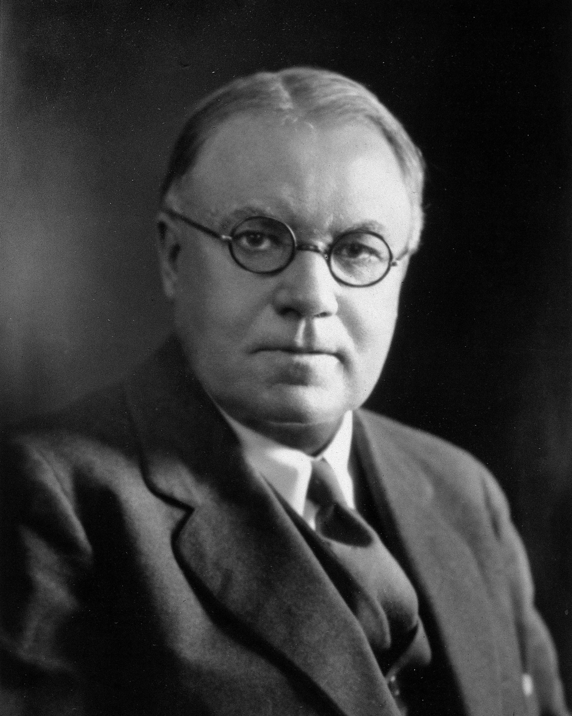
Walter Cannon
Developed the Cannon-Bard theory of emotion, which holds that physical and emotional stimuli happen simultaneously, with no causal relationship

Slide 9
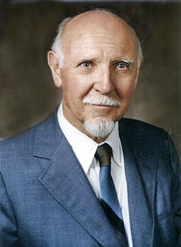
Raymond Cattell
Maintained that human personality consisted of 46 surface traits, from which could be derived 16 source traits that constitute personality
From this theory he developed (1950) the Sixteen Personality Factor Questionnaire

Slide 10
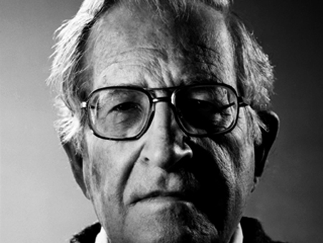
Noam Chomsky
A linguist
Chomsky performed research that led to the decline of behaviorist theories about language acquisition and encouraged researchers to study the biological bases of behavior
He proposed that humans are born with an innate language acquisition device that allows them to acquire language skills easily

Slide 11
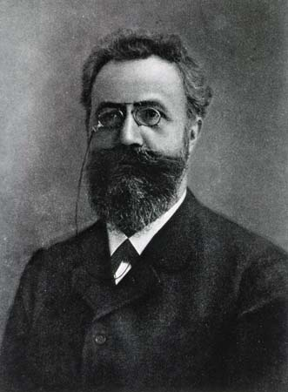
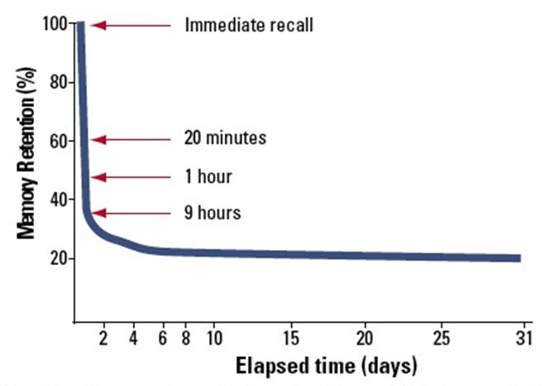
Hermann Ebbinghaus
A philosopher, psychologist, and author of On Memory
His work challenged the view that higher mental processes such as memory couldn’t be studied scientifically
Ebbinghaus Forgetting Curve

Slide 12
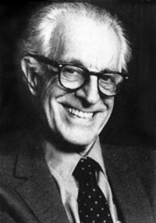
Albert Ellis
An American psychologist who developed a form of cognitive-behavioral therapy known as rational-emotive therapy
His rational-emotive therapy is based on the idea that self-defeating thoughts cause psychological problems

Slide 13
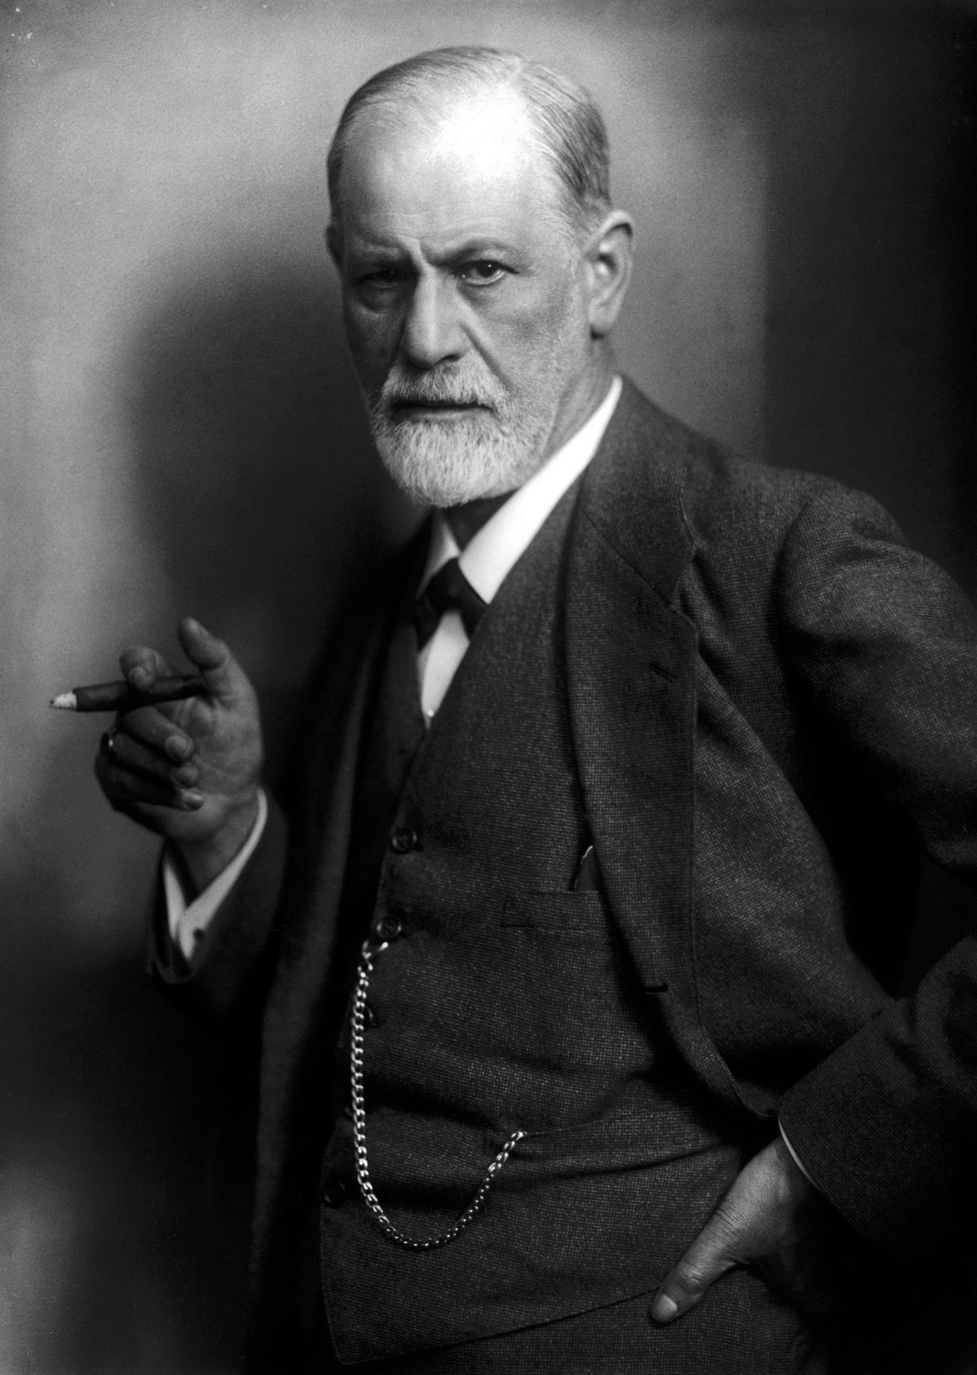
Sigmund Freud
An Austrian neurologist and pioneer in the field of psychoanalysis
Freud’s ideas, particularly his emphasis on sexuality, were highly controversial in the repressive Victorian era in which he lived
Dream Analysis
Unconscious
Id, Ego, Superego
Defense Mechanisms

Slide 14
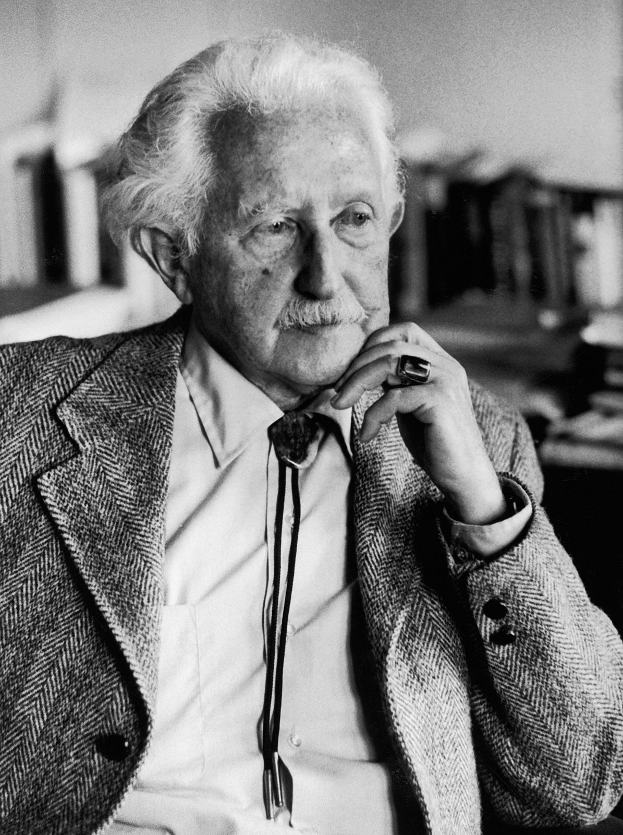
Erik Erikson
Erikson is best-known for his 8 Stages of Psychosocial Development and the concept of the identity crisis.
His theories marked an important shift in thinking on personality; instead of focusing simply on early childhood event, his psychosocial theory looked at how social influences contribute to personality throughout the entire lifespan.

Slide 15
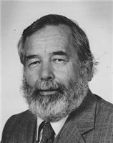
John Garcia
He conducted a series of studies on Conditioned Taste Aversion
In these studies, he manipulated the kinds of stimuli preceding the onset of nausea and other noxious experiments in rats, using radiation to artificially induce the nausea

Slide 16
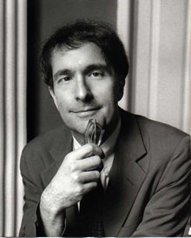
Howard Gardner
A developmental psychologist whose research focuses on creativity in adults and children
Gardner proposed a theory of multiple intelligences, which has been highly influential among educators

Slide 17
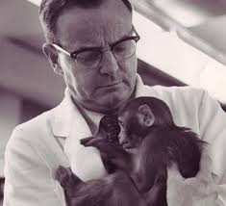
Harry Harlow
Professor Harlow’s research developed an abundant supply of primate learning tests and tasks that became standards in the field
Harlow’s famous wire/cloth “mother” monkey studies demonstrated that the need for affection created a stronger bond between mother and infant than did physical needs (food).

Slide 18
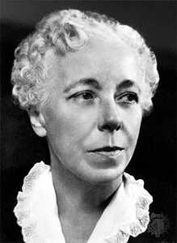
Karen Horney
She was a pioneering theorist in personality, psychoanalysis, and “feminine psychology.”
Anxiety is created by anything that jeopardizes a person’s means of gaining security
The neurotic’s rigid adherence to his safety devices protects him in some ways but renders him helpless toward other possible dangers.

Slide 19
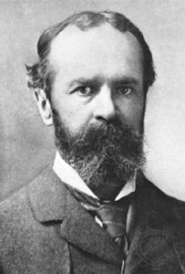
William James
An American philosopher and psychologist
James believed that the experience of emotion arises from bodily expression
According to his view, people are said BECAUSE they cry (not the other way around)
Contributed to development of the James-Lange theory of emotion

Slide 20
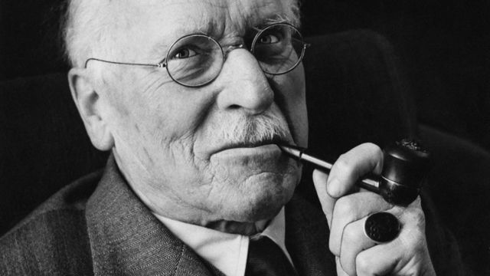
Carl Jung
Swiss psychologist and psychiatrist who was a friend and follower of Freud
Jung broke away from Freud in the 1910s because of a bitter theoretical disagreement
Began his own school of thought- analytical psychology
Thought the will to live was a stronger motivator than sexual drive in humans
Collective unconscious- contains universal human memories

Slide 21
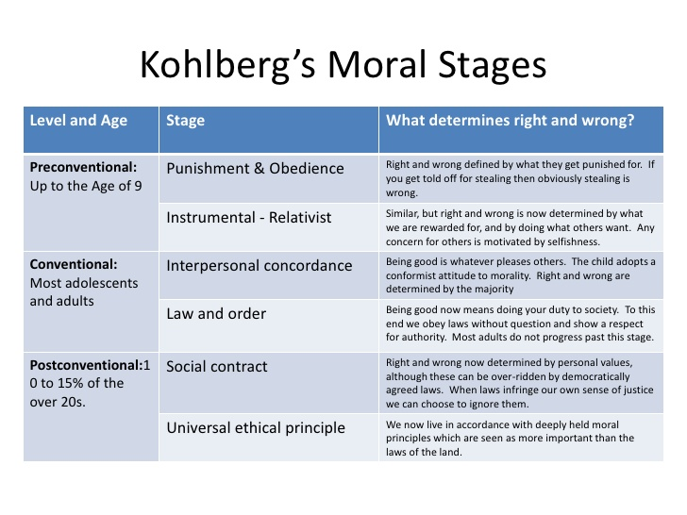
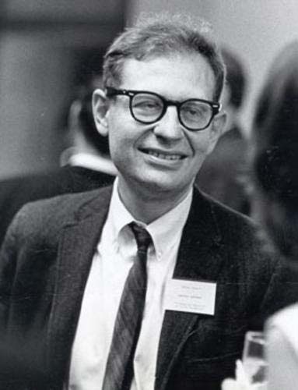
Lawrence Kohlberg
A major figure in moral psychology and moral education
Kohlberg had a passionate commitment to building a just society
Kohlberg’s 6 Stages of Moral Development

Slide 22
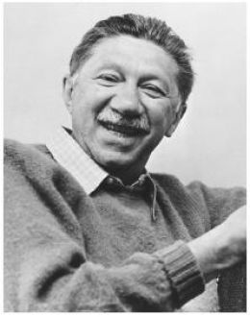
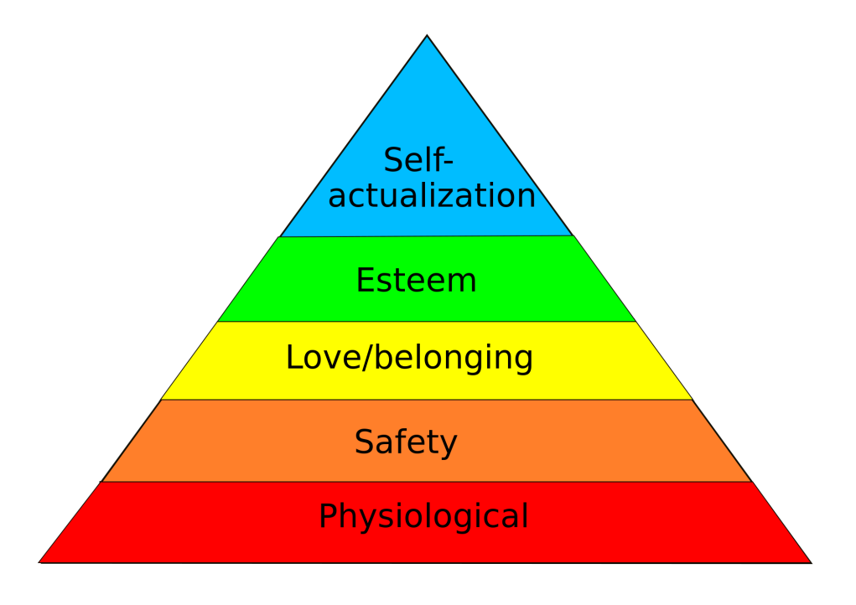
Abraham Maslow
Leader in the field of humanistic psychology
Believed human beings’ needs are arranged like a ladder- said basic needs such as the needs for oxygen, food, and water are at the bottom of this ladder, while higher needs such as the need to achieve one’s full potential are at the top of the ladder
Self-Actualization

Slide 23
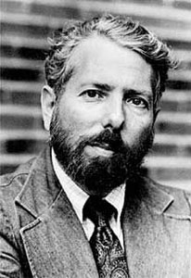
Stanley Milgram
Conductor of a famous, controversial research study of obedience to authority
Found that his experiment subjects were willing to cause serous harm and suffering to others if instructed to do so by an authority figure.
Milgram had to deceive his subjects in order to do his study- many researchers objected to his use of deception and questioned the ethics of the research

Slide 24
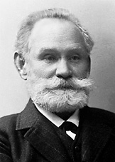
Ivan Pavlov
Classical Conditioning
Pavlov made his most famous discovery while studying how dog saliva related to the function of the stomach.
He repeatedly gave a dog food after ringing a bell. The dog began to salivate for false alarms too. The bell rang, the dog salivated, even with no food in sight.
He won a Nobel Prize for his work in 1904

Slide 25
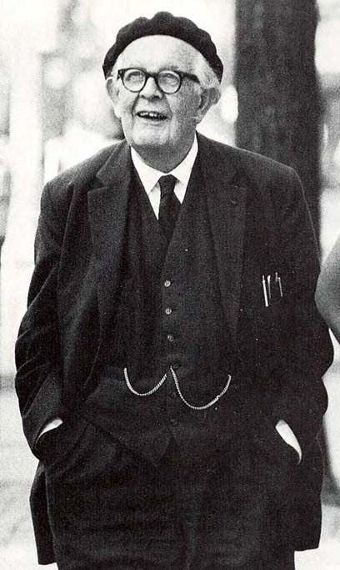
Jean Piaget
Developmental psychologists
Piaget’s Stages of Cognitive Development
His contributions include a theory of cognitive child development, detailed observational studies of cognition in children, and a series of tests to reveal cognitive abilities

Slide 26
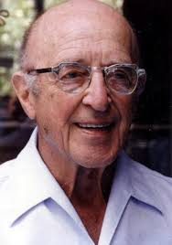
Carl Rogers
An American psychologist who proposed the person-centered or client-centered theory of psychology
Rogers asserted that people’s self-concepts determine their behavior and relationships with others
Rogers also believed that the relationship between a therapist and client was crucial in the treatment of psychological disorders

Slide 27
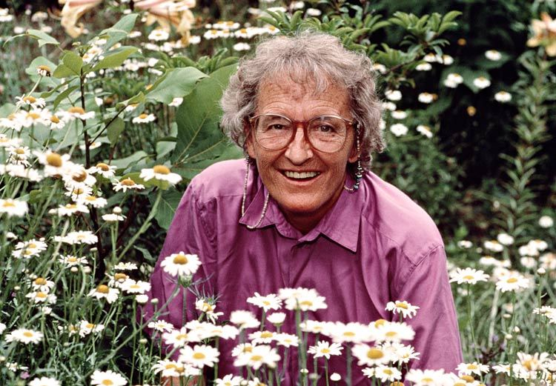
Elizabeth Kubler-Ross
Interviewed over 200 dying patients
She identified 5 stages of psychological adjustment
Denial
Anger
Bargaining
Depression
Acceptance

Slide 28
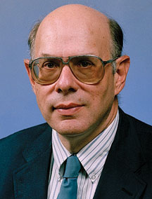
Stanley Schachter
The developers of the two-factor theory of emotion
Schachter and Singer believed that emotions come both from psychological stimuli and the cognitive interpretation of that stimuli

Slide 29
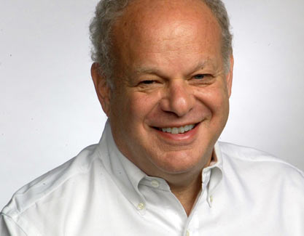
Martin Seligman
Pioneer in the field of “positive psychology,” the study of what makes people happy and good.
Contrasts traditional clinical psychology, which focuses on what makes people distressed
Discovered the phenomenon of learned helplessness in dogs

Slide 30
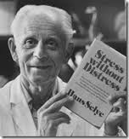
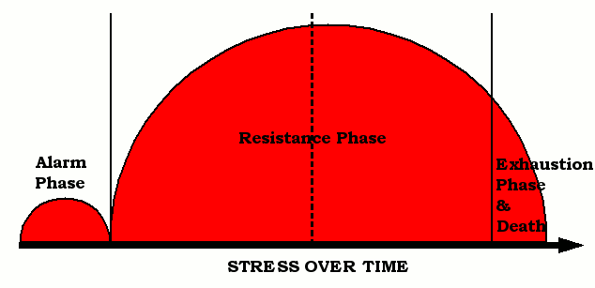
Hans Selye
A Viennese-born endocrinologist who pioneered the field of stress research
Concluded that physiological response to stress is nonspecific
General Adaptation Syndrome – Alarm Resistance Exhaustion (GAS-ARE)

Slide 31
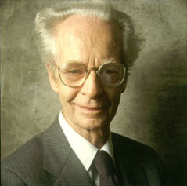

B.F. Skinner
Behavioral psychologist who built on Pavlov’s work to develop theories of operant behavior
Skinner studied operant conditioning by using the Skinner Box

Slide 32
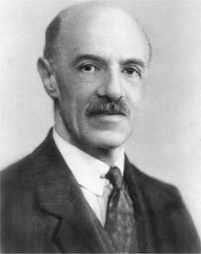
Charles Spearman
Cognitive psychologist who theorized the existence of a general type of intelligence, the “g” factor, that underlies all types of intelligence
General Intelligence Theory

Slide 33
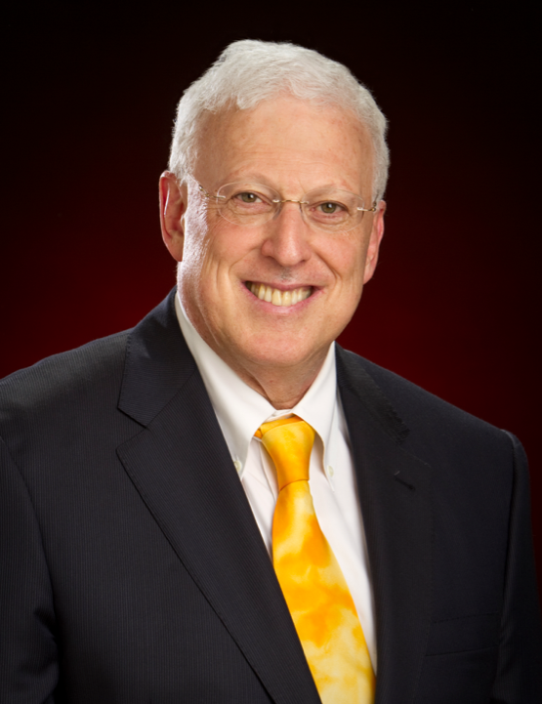
Robert Sternberg
The developer of the Triarchic Theory of Intelligence
Proposed there are three aspects to intelligence: componential, experiential, and contextual

Slide 34
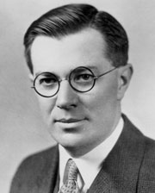
Lewis Terman
A developer of the Stanford-Binet Intelligence Scale in 1916, a revision of the Binet-Simon scale.
Believed in the existence of innate differences in intelligence and supported the eugenics movement of his time
Advocated widespread use of intelligence testing
Lewis Terman’s “Termites”

Slide 35
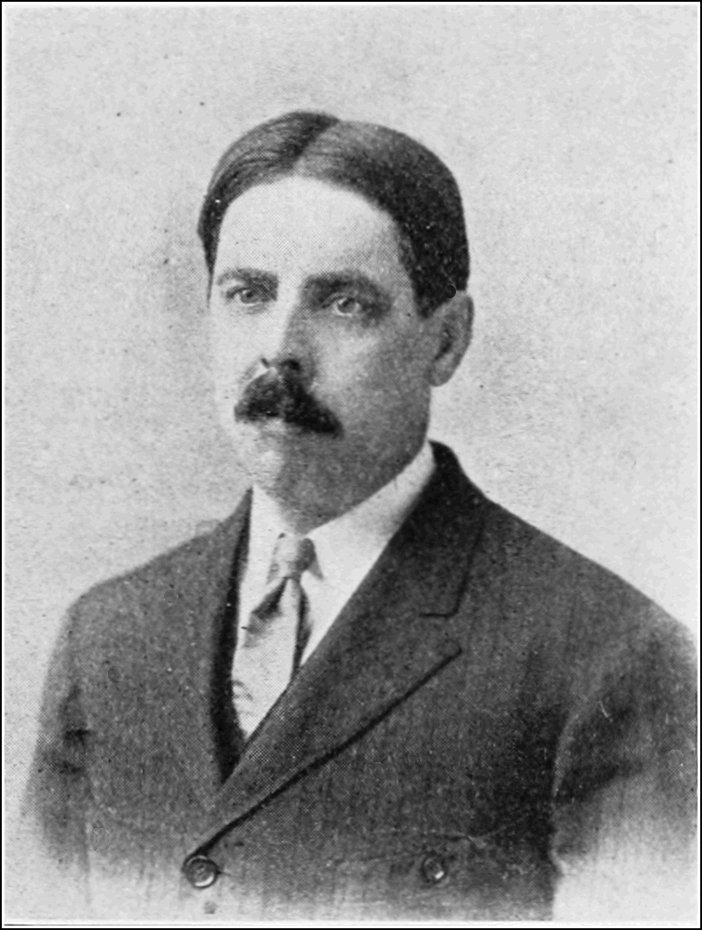
Edward Thorndike
Studied learning and classical conditioning, primarily in animals
Formulated the Law of Effect- any behavior that is followed by a pleasant consequence is likely to be repeated, while any behavior followed by unpleasant consequences is likely to be stopped

Slide 36
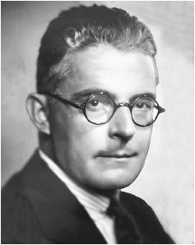
John Watson
Founder of a school of psychology known as behaviorism
Watson studied the effects of conditioning on children
One of his most famous experiments involved conditioning a child named Little Albert to fear white, furry objects

Slide 37
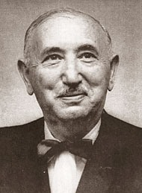
David Wechsler
Designed the fist intelligence test specifically for adults
Called the test the Wechsler Adult Intelligence Scale (WAIS)
Also devised a test for children called the Wechsler Intelligence Scale for Children

Slide 38
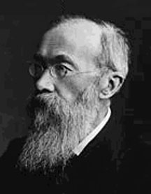
Wilhelm Wundt
Best known for establishing the first psychology lab in Leipzig, Germany, generally considered the official beginning of psychology as a field of science separate from philosophy
Father of Psychology, so…
Turn down for Wundt?!

Slide 39
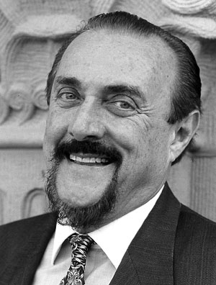
Phillip Zimbardo
Most notable study was the 1971 Stanford Prison Experiment, which was a classic demonstration of the power of social situations to distort personal identities and long cherished values and morality as students internalized situated identities in their roles as prisoners and guards

